Slide 1
Selenium – Automation Testing Tool

Slide 2
Selenium
Used as Automation Testing Tool
Open source
Written in Java, C#, Ruby, Python, Perl, PHP
Used for testing dynamic web applications

Slide 3
What we will need ?
Java – To write Scripts
Eclipse – To compile and Run Scripts
Selenium – Framework for testing Web Apps

Slide 4
Installation Steps
Install Java (Standard Edition) → setup environment variables
Install Eclipse
Download Selenium JAR files

Slide 5
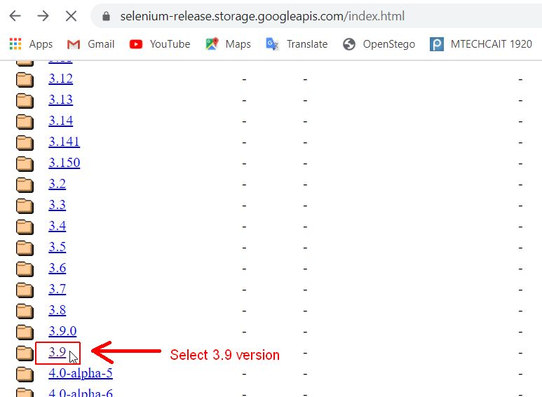
Selenium files download
https://selenium-release.storage.googleapis.com/index.html

Slide 6
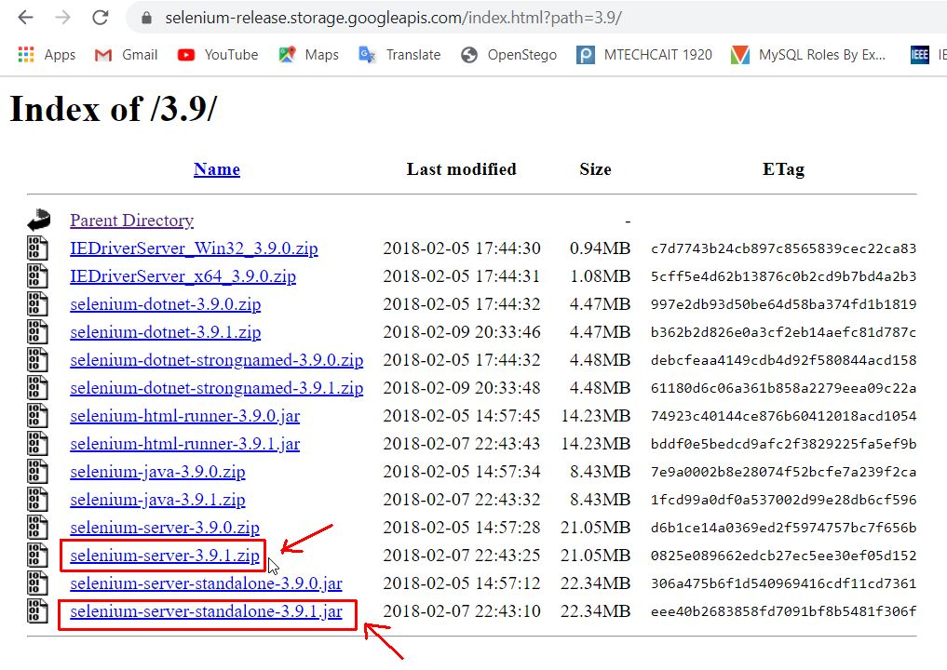
Download selenium-server-3.9.1.zip and selenium-server-standalone-3.9.1.jar

Slide 7
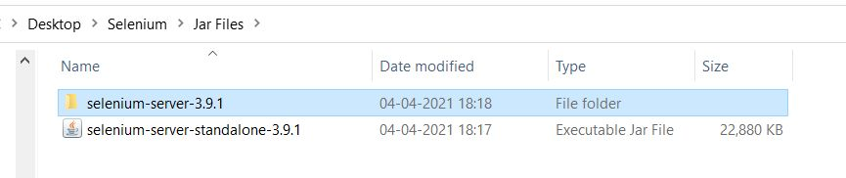
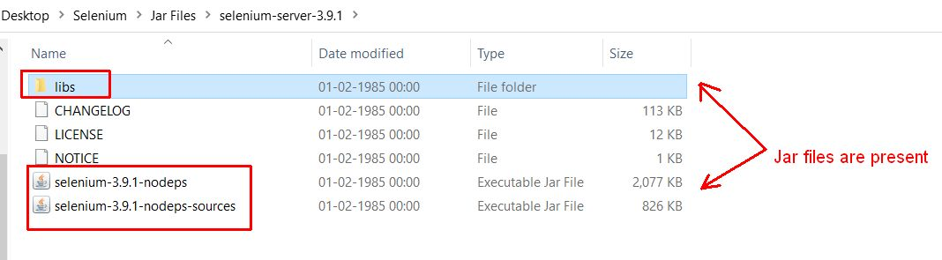
Extract selenium-server-3.9.1.zip in a folder. It consists of JAR files.
JAR stands for Java ARchive. JAR file is used to aggregate many Java class files and associated metadata and resources (text, images, etc.) into one file.

Slide 8
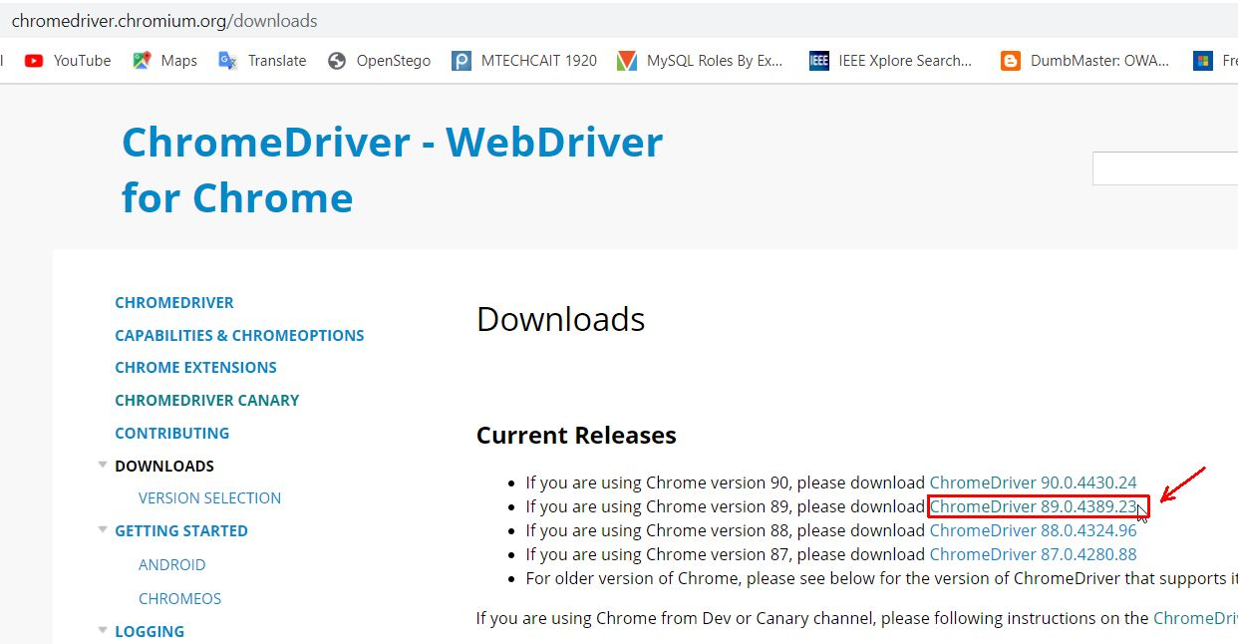
Chrome Web Driver: https://chromedriver.chromium.org/downloads

Slide 9
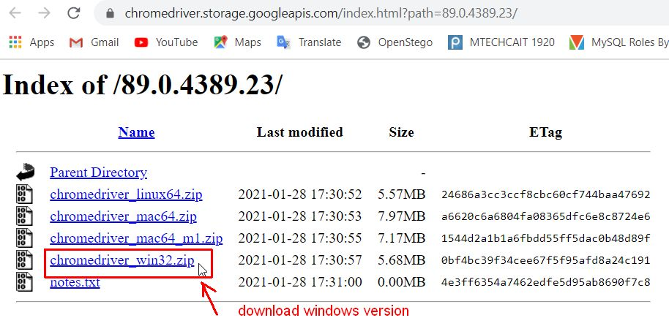
Download Chrome Web Driver for Windows OS. Chromedriver is used to access the web applications that run on chrome browser

Slide 10
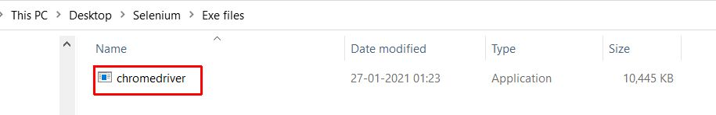
Extract chromedriver_win32.zip file which contains chromedriver.exe file. This chromedriver.exe file will be used to access the web applications through Chrome Browser.

Slide 11
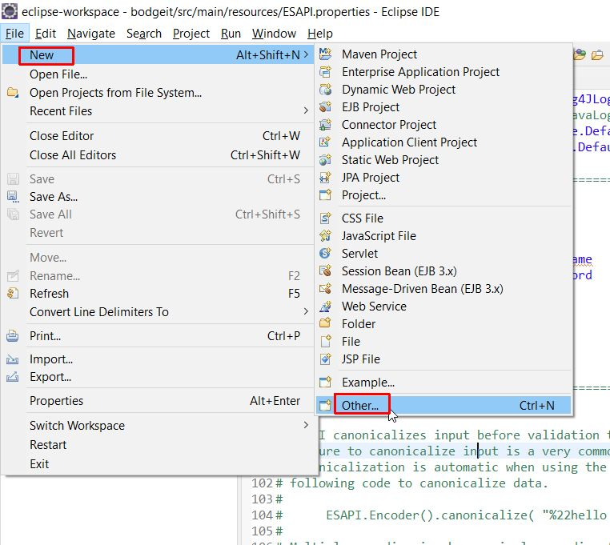
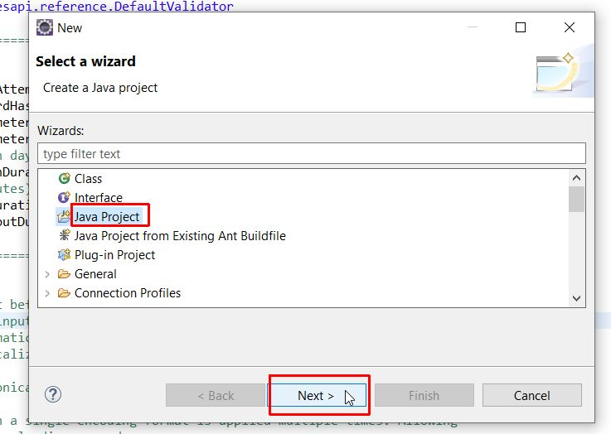
Setting Up Selenium in Eclipse
Create new Java Project → Name it as Selenium Project

Slide 12
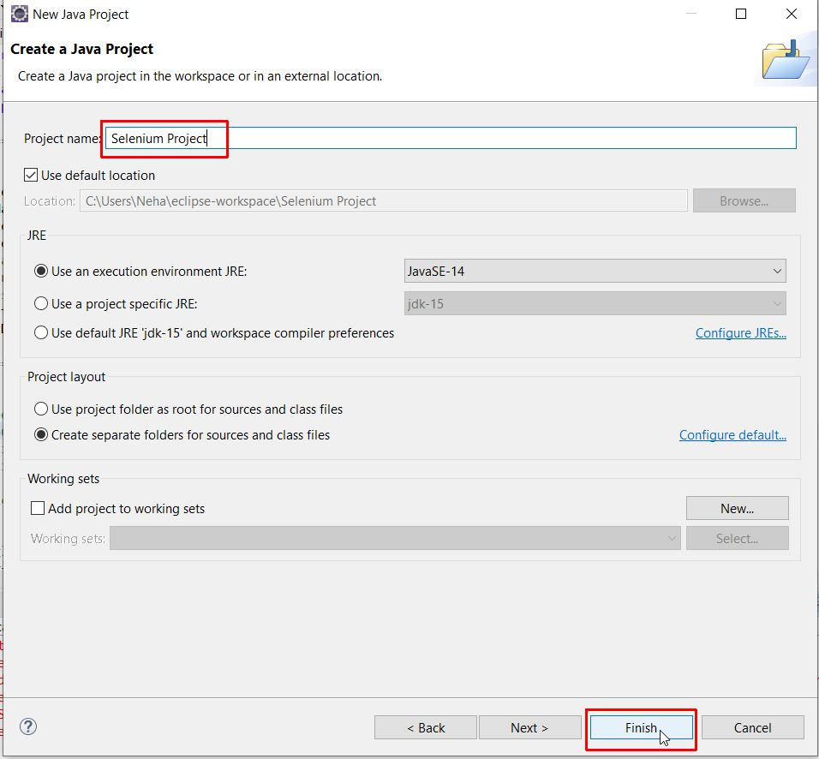

Slide 13
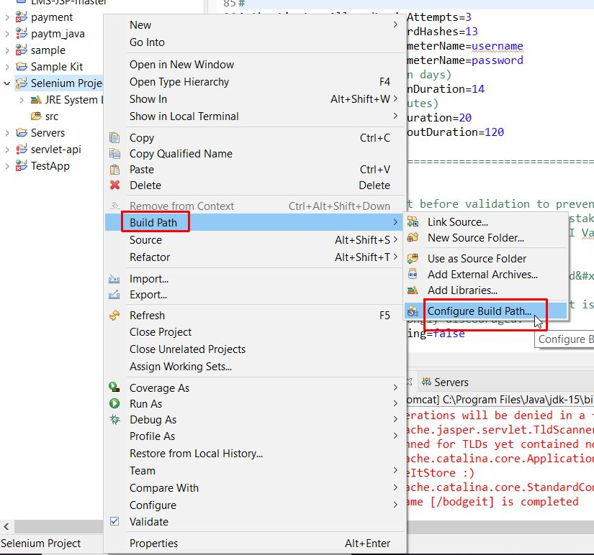
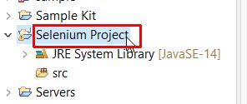
Right click on Selenium Project → select ‘Build path’ → select ‘Configure build path’
Configure Build Path is used
to add external JAR Files
in a project in Eclipse

Slide 14
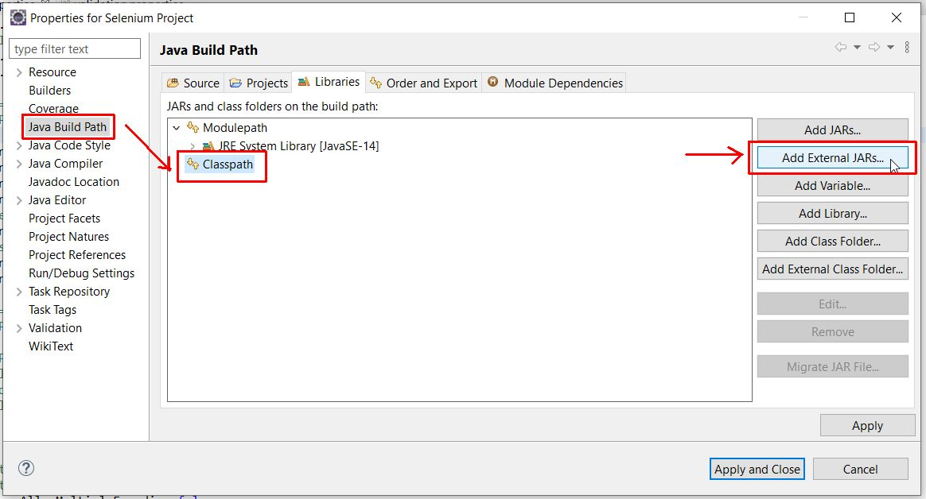
Select Java Build Path → select Classpath → click Add External JAR files

Slide 15
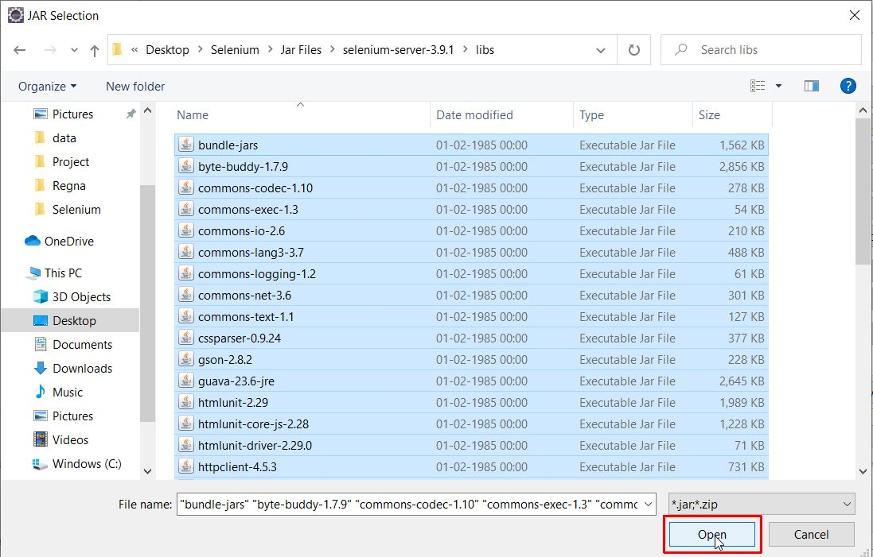
Select the jar files in libs folder, selenium-server-3.9.1 folder and selenium-server-standalone-3.9.1.jar file

Slide 16
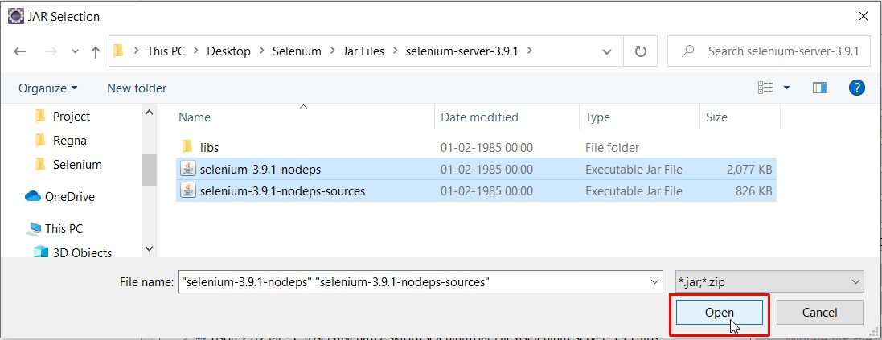
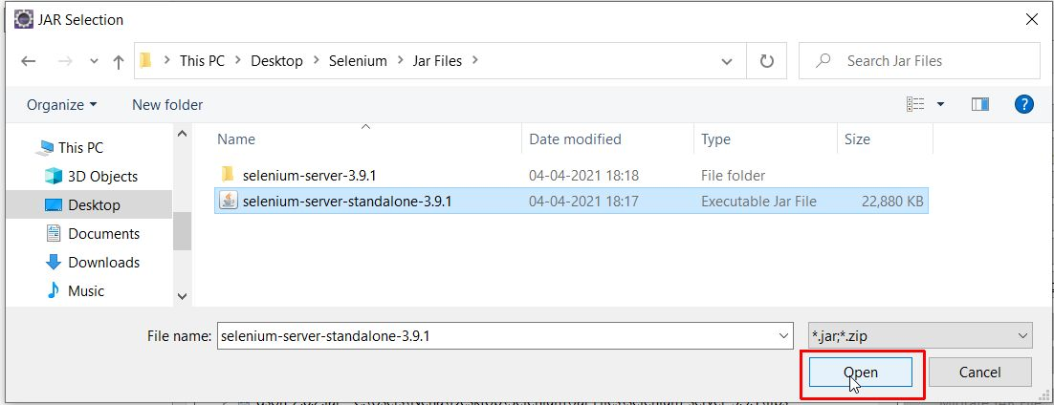

Slide 17
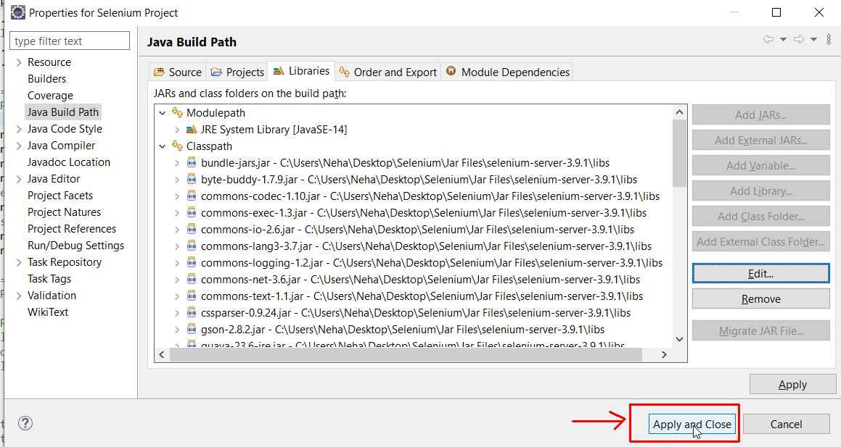
Once All the JAR files are selected, click on Apply and Close

Slide 18
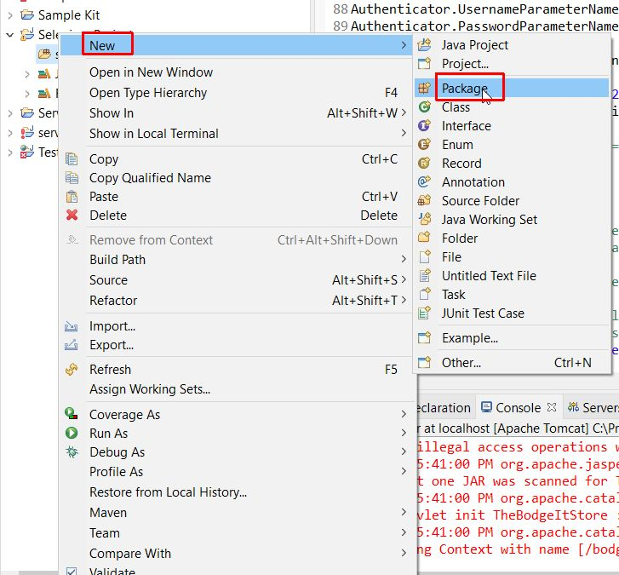
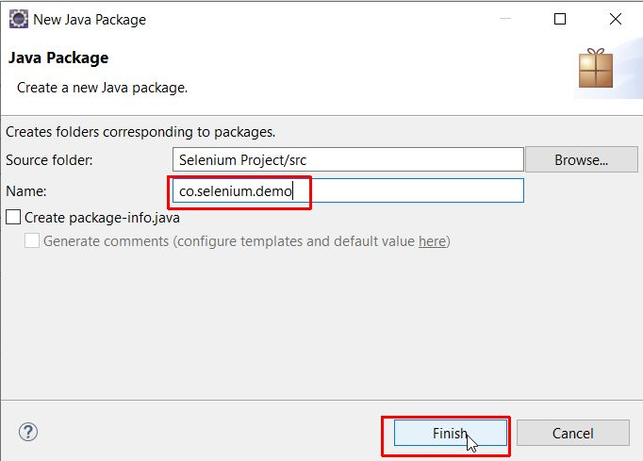
Create new Package to write the test cases in src folder of the Project

Slide 19
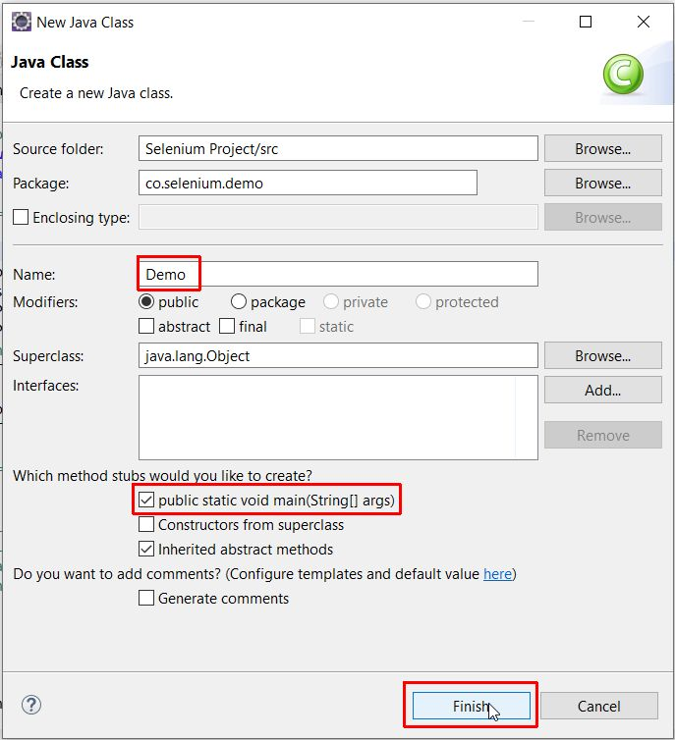
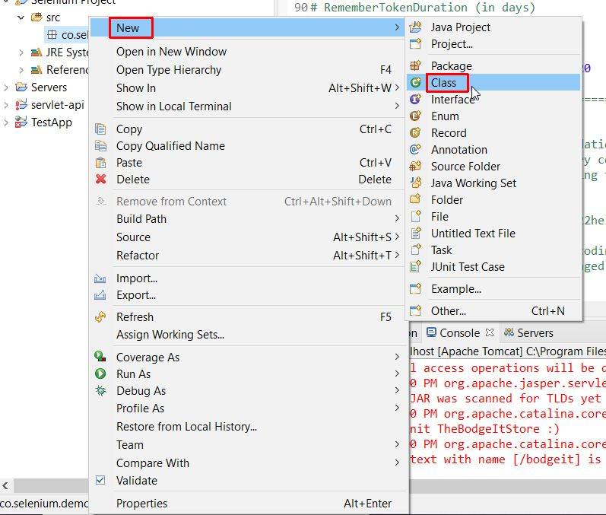
Create a class in Package, name it and select public static void main

Slide 20
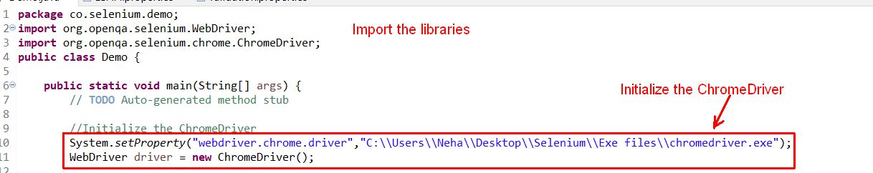
Writing Test Cases
First initialize the web driver using Chrome web driver

Slide 21
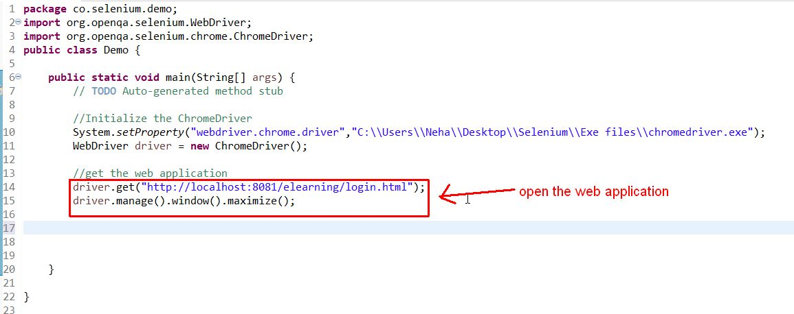
We can the open the web application using driver.get(“web-url”)

Slide 22
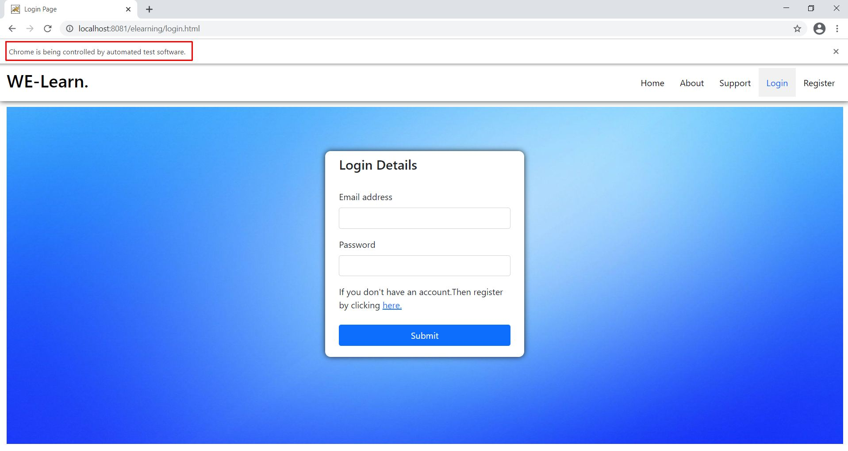
When we run the program, your web application project runs

Slide 23
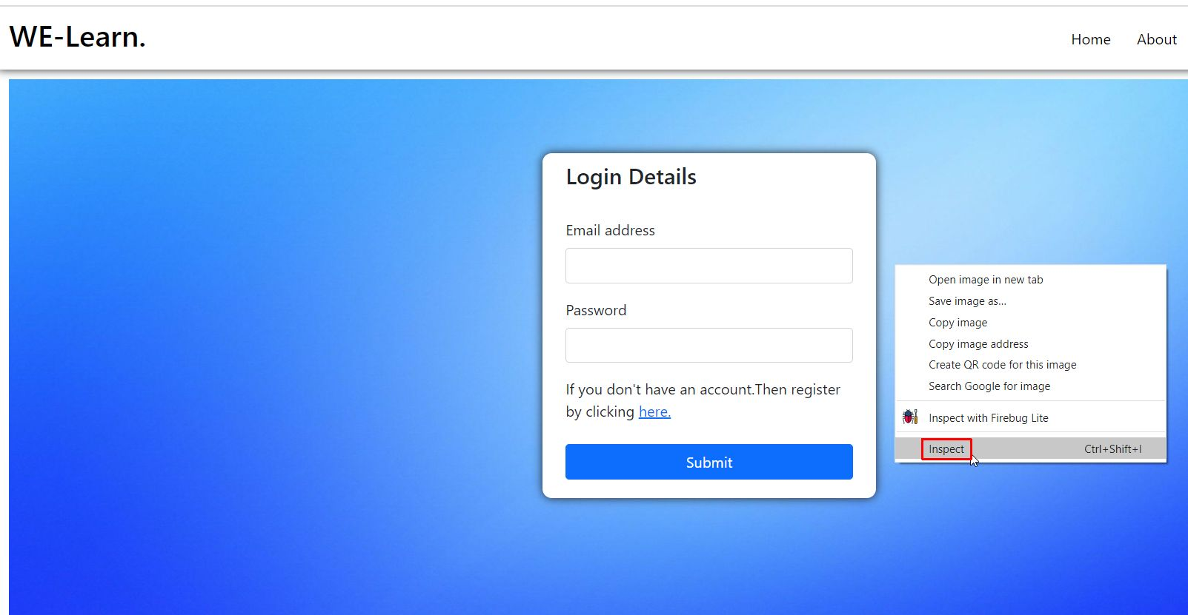
Now we will need to inspect the elements of web application right click on web page of e-learning application, you will get this menu with inspect button. Now click on inspect button to get web app code

Slide 24
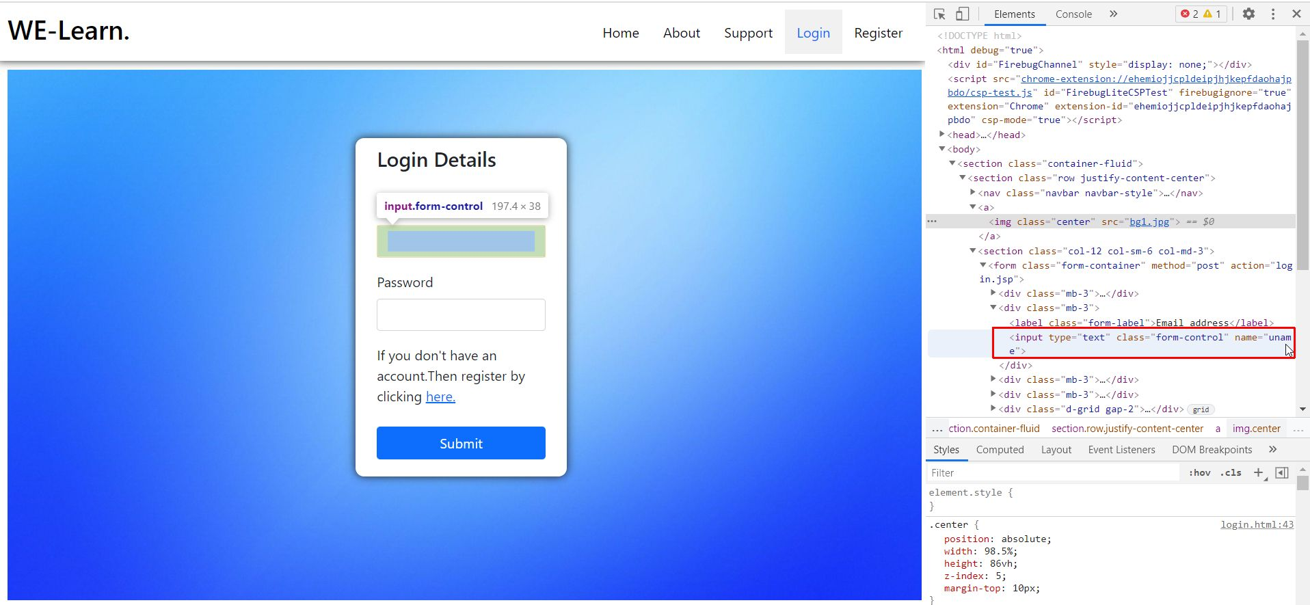
The code of web application that you have implement will be displayed on the screen. When the attribute Username on the login Form is clicked, the code of attribute username gets highlighted

Slide 25
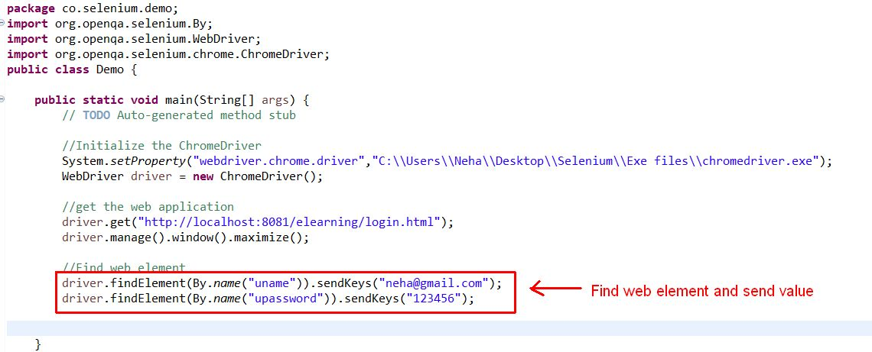
Find the input elements and send values using sendKeys() function

Slide 26
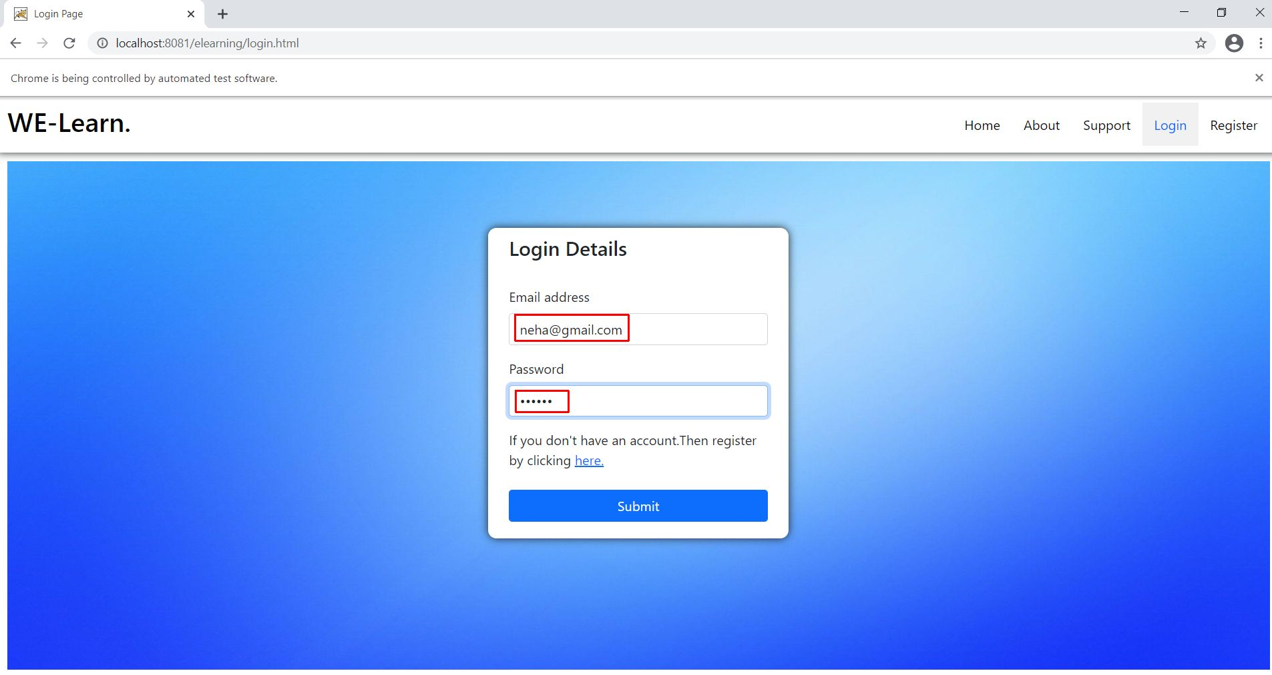
The data passed through the code is automatically filled when the program runs.

Slide 27
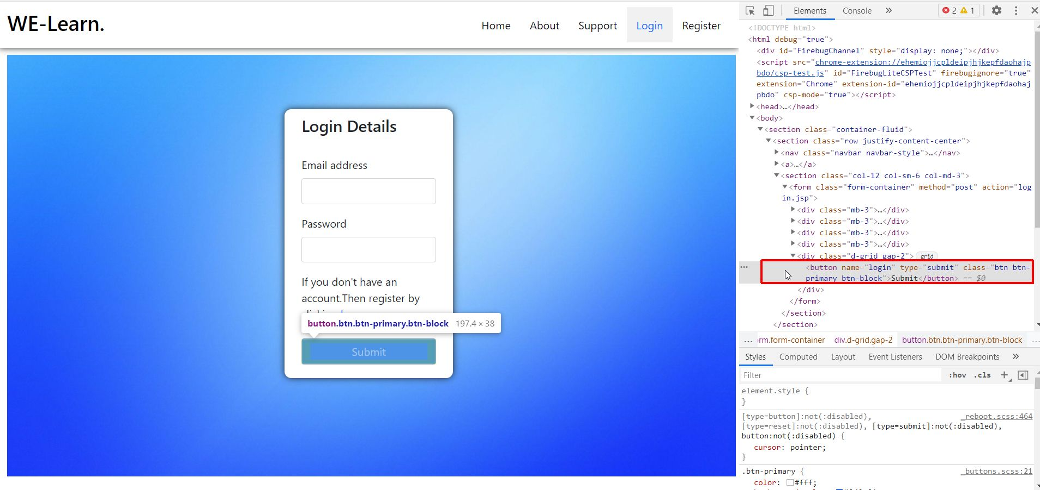
Similarly, we can get the code for Submit button, from there we can get the name of the button.

Slide 28
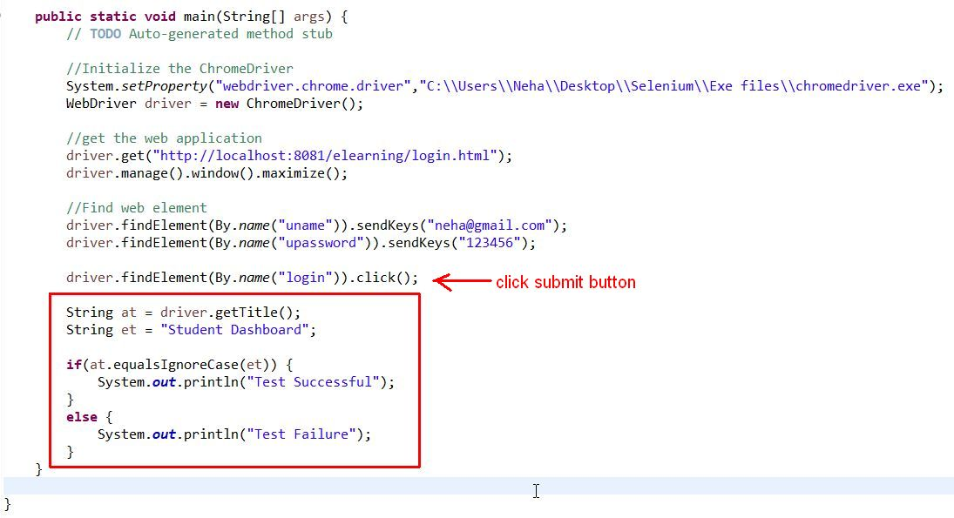
Compare the title to check whether the Test case is successful

Slide 29
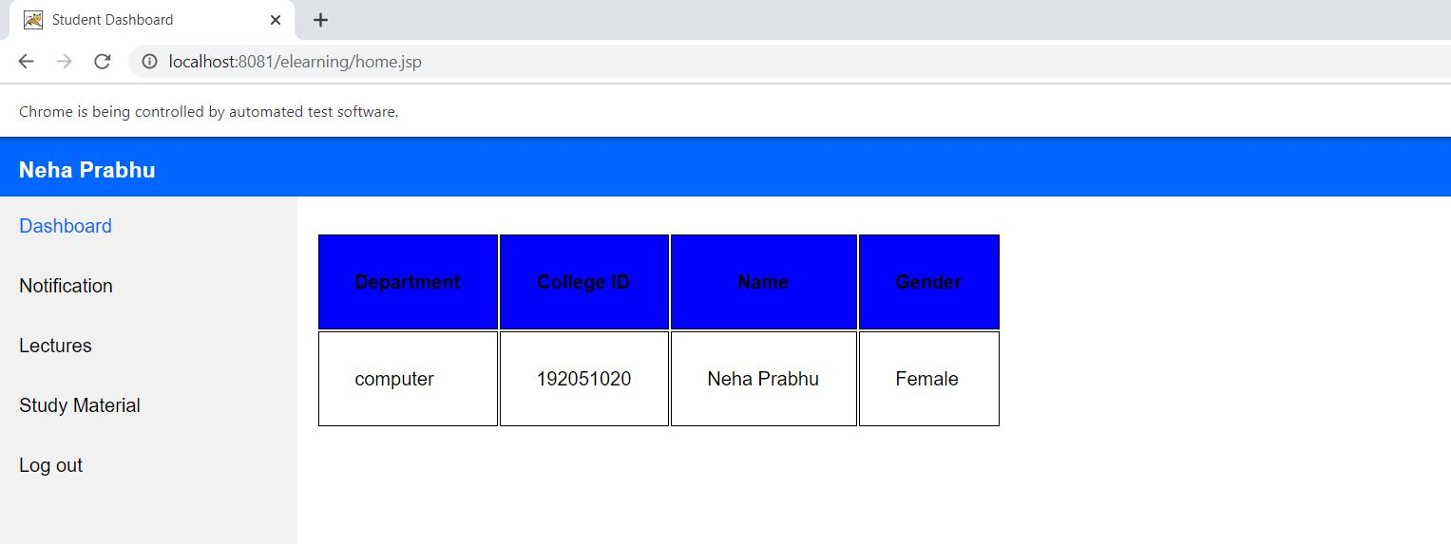
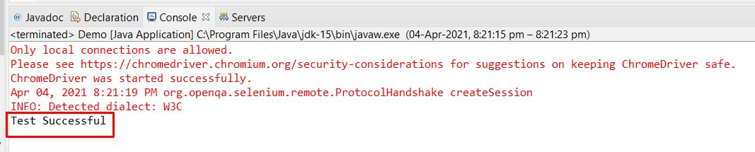

Slide 30
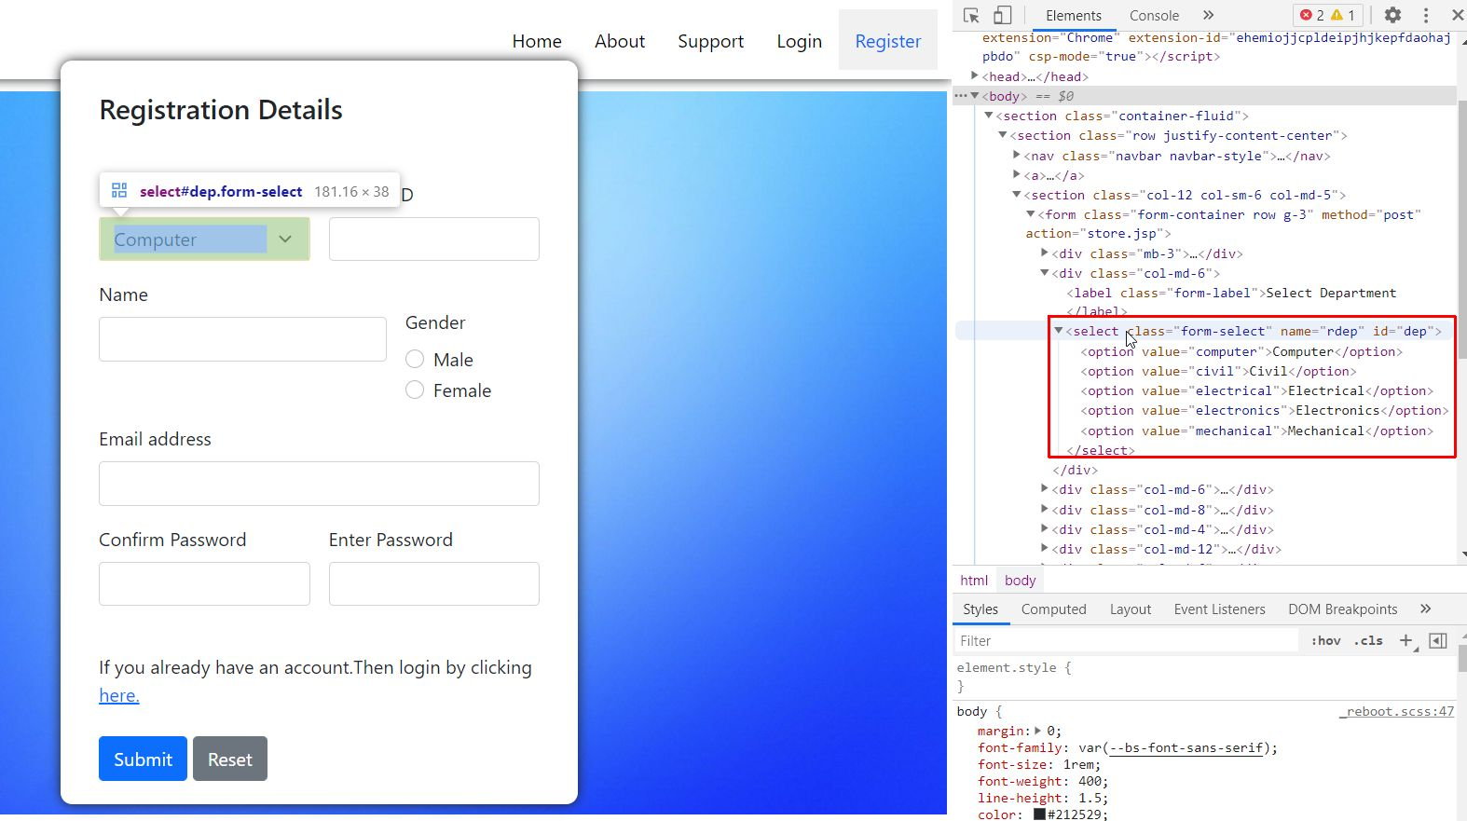
For dropdown list, first get the name of element

Slide 31
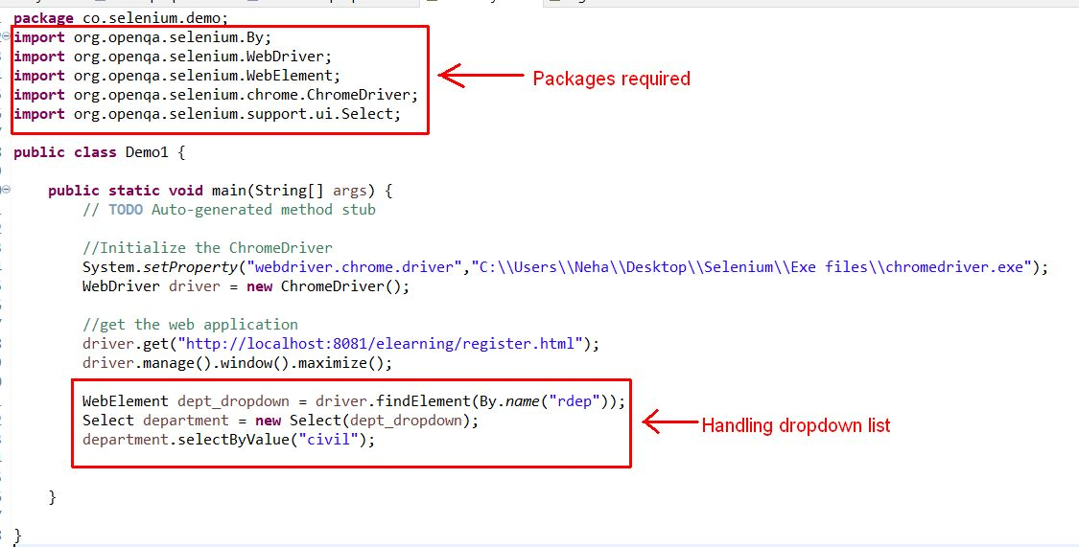
Find the element, then use Select class → selectByValue()

Slide 32
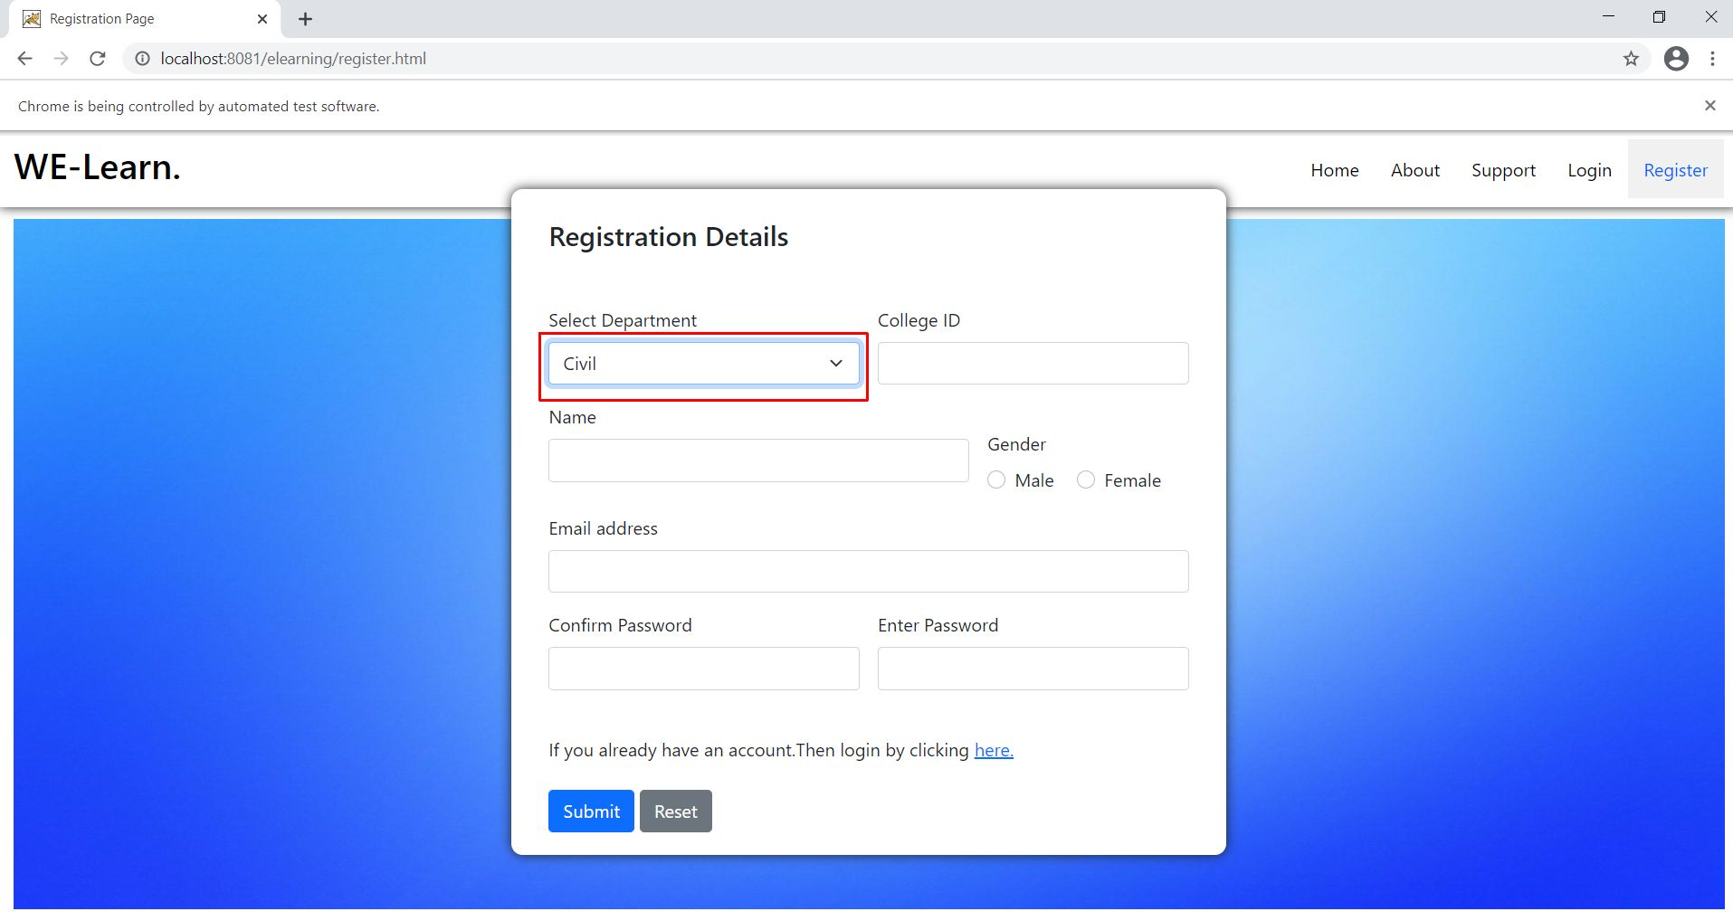

Slide 33
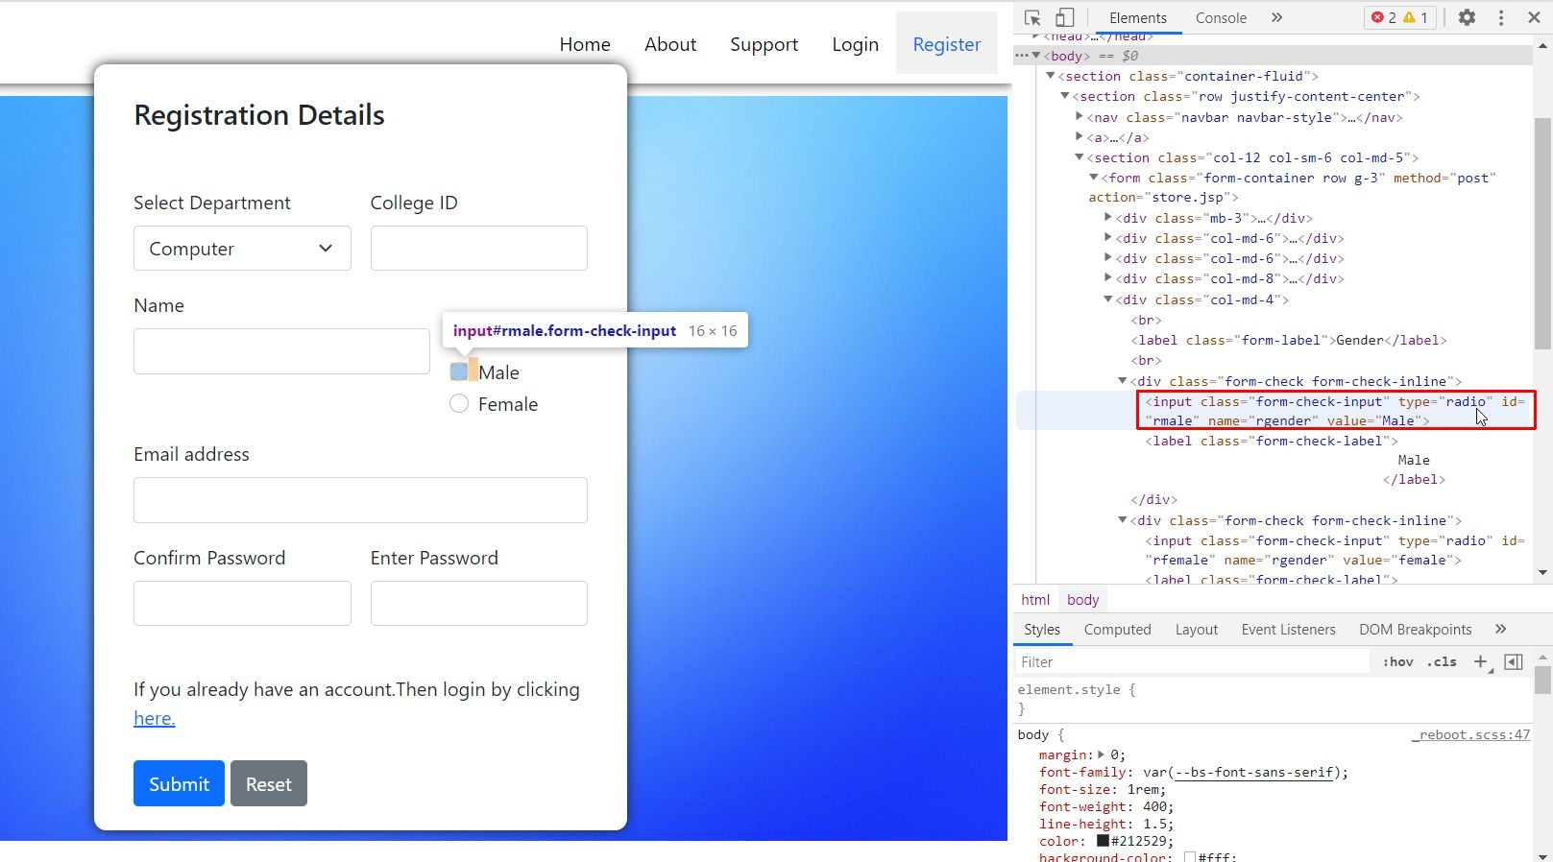
For radio buttons, first get the id of element

Slide 34
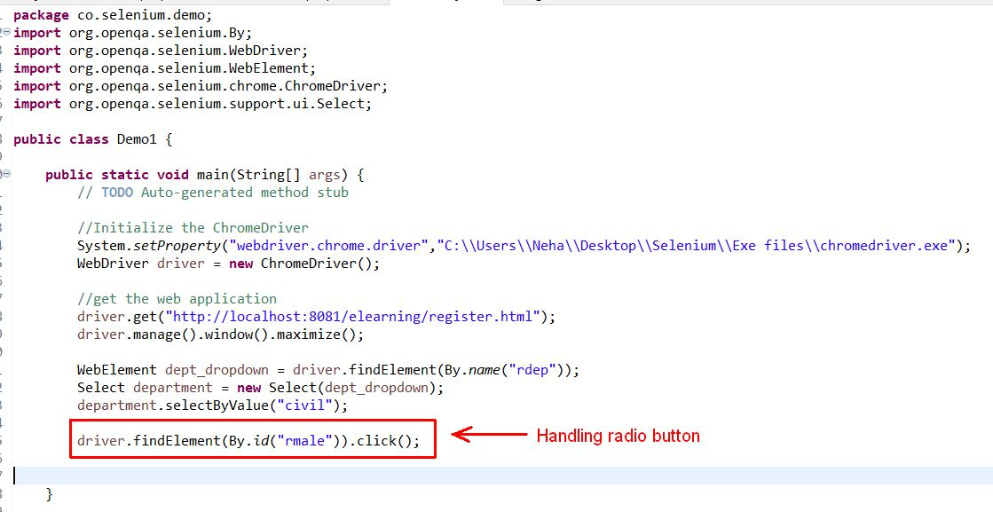
Find the radio element and click

Slide 35
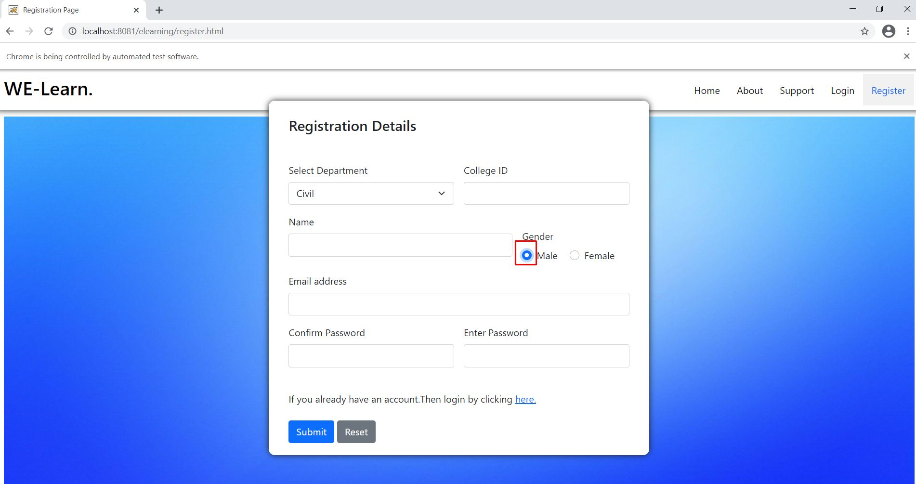

Slide 36
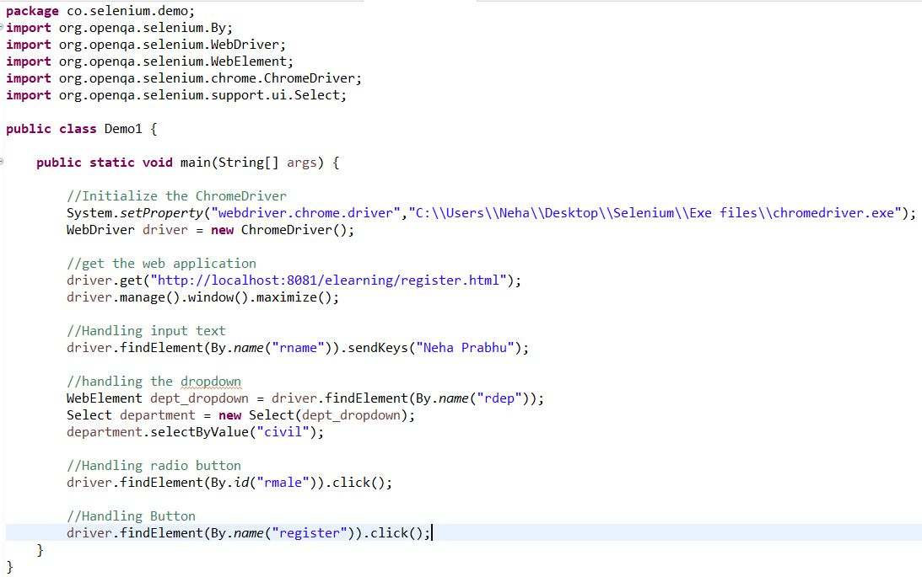
Program for Reference – Handling various form elements

Slide 37
References
Selenium
https://www.youtube.com/watch?app=desktop&v=_JNeiGbAgL4
https://www.youtube.com/watch?v=H322v_HRzC8
https://www.youtube.com/watch?v=BKbzW4S2qQ0

Slide 38
Thank You

